Slide 1
Lab 2: Isolated Word Recognition
Ying shen
School of software engineering
tongji university

Slide 2
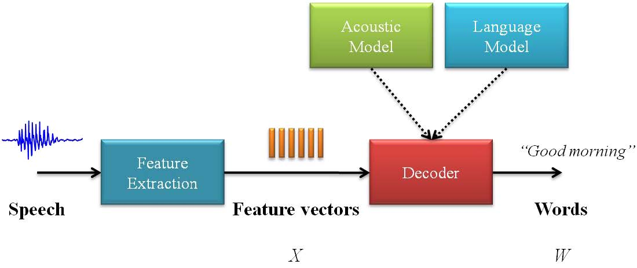
Architecture of an ASR system

Slide 3
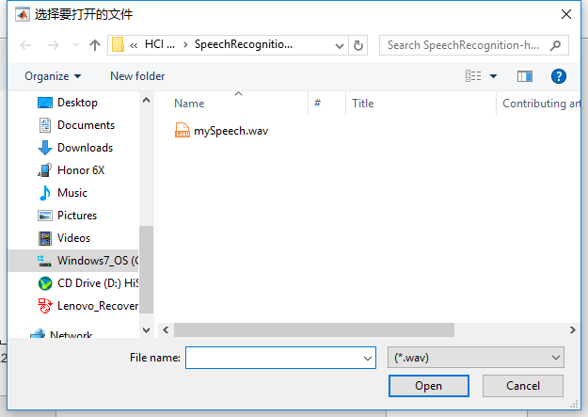
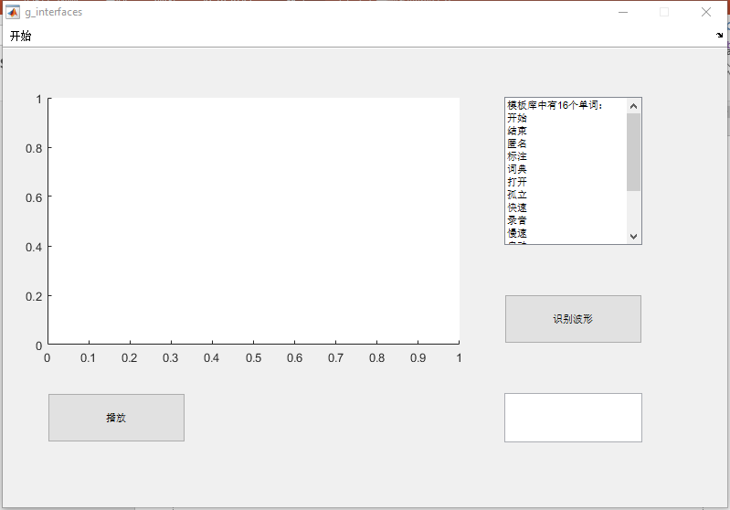
Isolated word recognition based on HMM
Train HMM
main.m
Record a test speech
speechRecord.m
Run GUI
g_interfaces.m
2.
1.
3.

Slide 4
Assignment
Run SpeechRecognition-hmm. Get familiar with the program.
Train another HMM using your own speech/words and modify GUI accordingly.
Add a new function: Record test audios using Stat/End button
Save training/test audios in different subdirectories

Slide 5
Report
Describe what you have done in the training and test progress. The report should answer the following questions:
The words to recognize
The number of training samples
The modifications to GUI and the codes
The accuracy of speech recognition and how to improve it, if possible?
Analyze the impact of different number of hmm states on recognition accuracy.
Submit your work (code and report) to TA
Prepare a readme file to illustrate how to run your program
Compress the code (including all your .wav files and the readme file) and the report into a zip file: ID_name_lab2.zip
Email address: hci2018@163.com

